Slide 1

Introduction to GIS for
History
EMPIRICAL REASONING CENTER 2019

Slide 2
WORKSHOP OBJECTIVES
- Understand the main uses of GIS technologies and software in historical and archaeological studies, what GIS is, how works and the standard GIS work model
- Become familiar with GIS software
- Learn about the conventions of map-making, map literacy, and what makes a ‘good’ map
- Learn to access, organize, and display data in QGIS, as well as some useful sources of data
- Learn how to create a map in QGIS, from importing the data to exporting a final map as an an image or PDF document

Slide 3
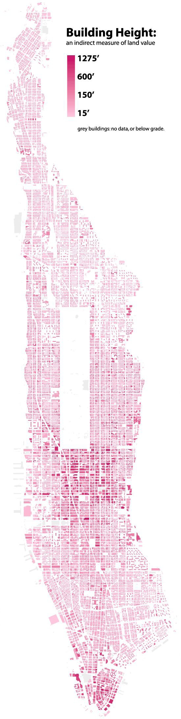
WHAT IS GIS?
Geographic Information Systems (Science)
GIS allows you to process, analyze and visuazlize information about the Earth’s surface. GIS is utilized to know “what is where, when” and is used in many different fields like environmental science, economics, history, archaeology, urban studies, biology, sustainable development, geology, etc. It’s a flexible tool that allows you to study spatial relationships, PAST AND PRESENT.
“Everything is related to everything else, but near things are more
related than distant things.”
(First rule of geography)

Slide 4
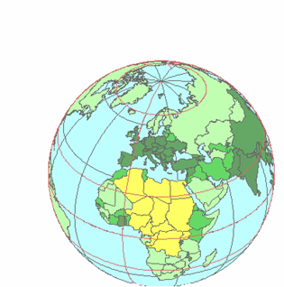
GIS MODEL
Data is organized in layers, that can be overlayed, compared, and used to represent thematic, quantitative, qualitative, narrative or conceptual information about the world.
These layers can be generated from historical maps, document and satellite images, as well
as field notes, surveys, etc.
Administrative Boundaries Utilities
Zoning Buildings Parcels Hydrography Streets
Digital Orthophoto

Slide 5
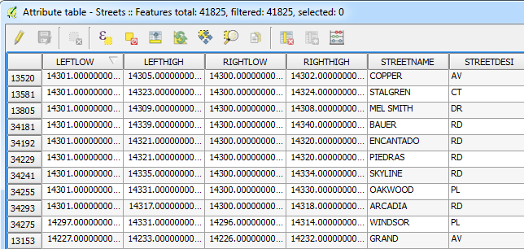
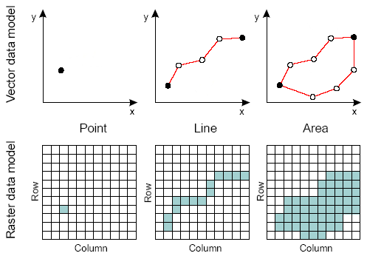
SPATIAL DATA
ATTRIBUTE DATA
specifies characteristics for that location information, like how much, when, what , etc.
STORED AS TABULAR DATA
specifies where (location) and what kind of feature (shape)
STORED AS GEOGRAPHIC DATA EITHER IN VECTOR OR RASTER FORMAT
TYPES OF DATA

Slide 6
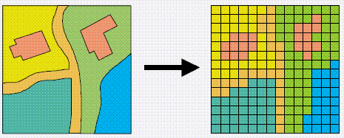
SPATIAL DATA
VECTOR
RASTER

Slide 7
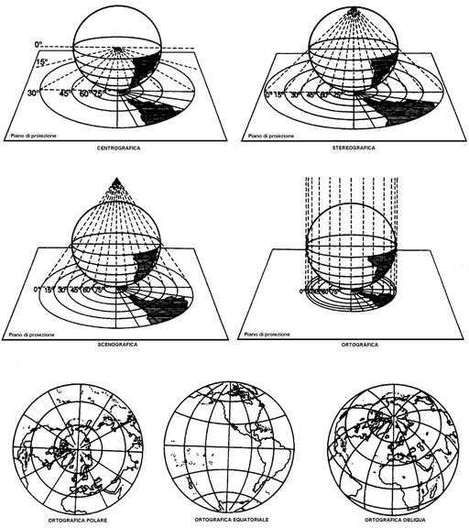
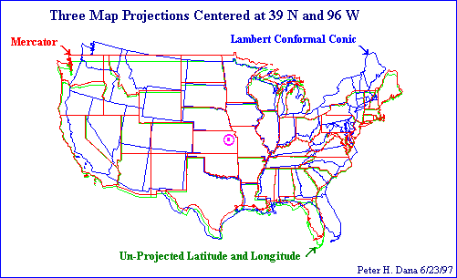
PROJECTIONS &
COORDINATES SYSTEMS

Slide 8
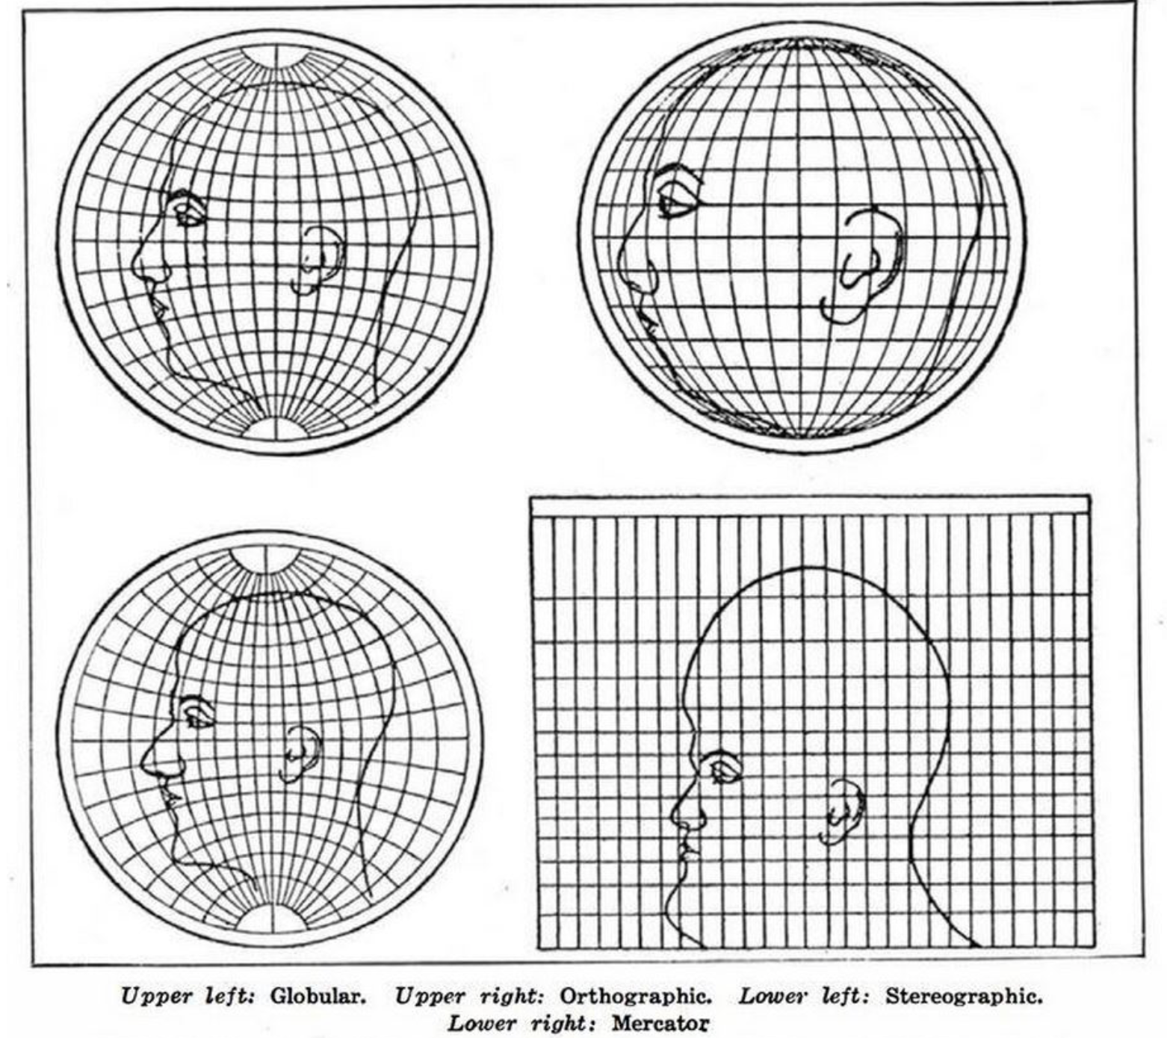
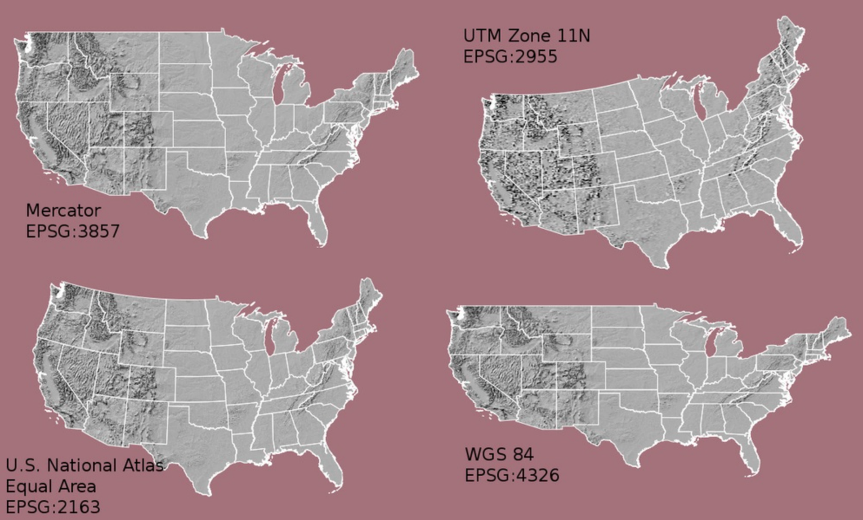
TRUE SIZE

Slide 9
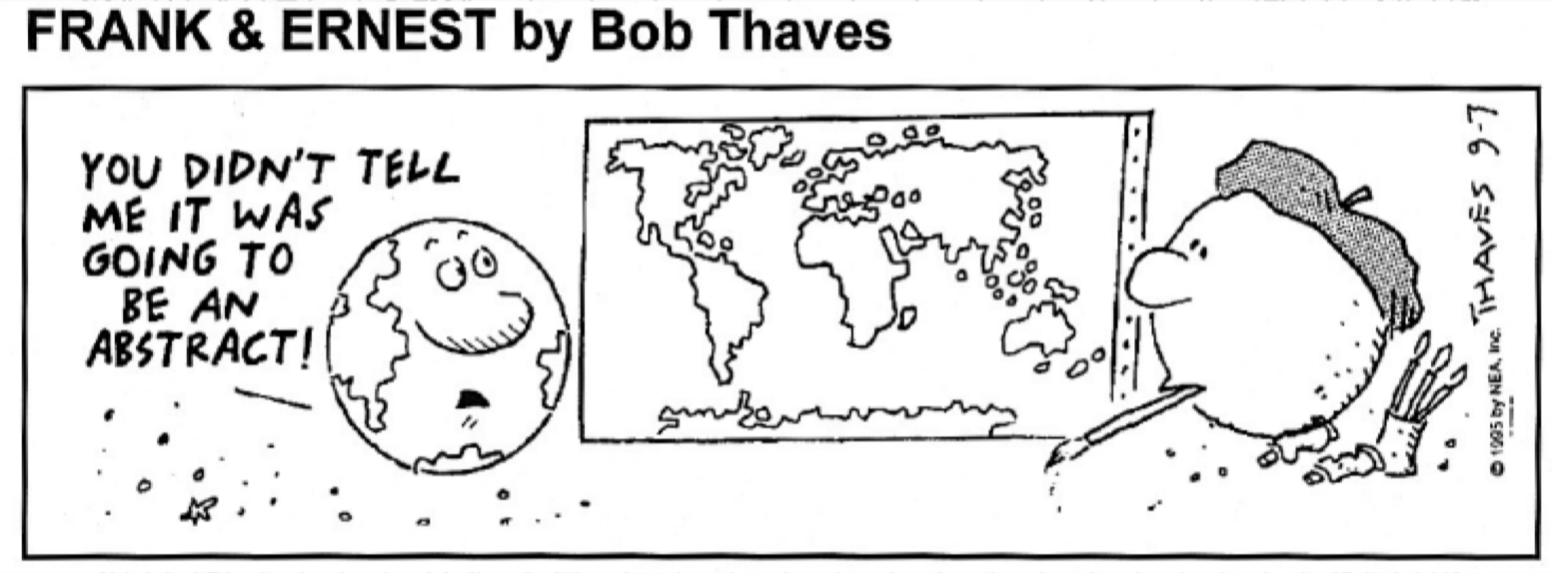

Slide 10
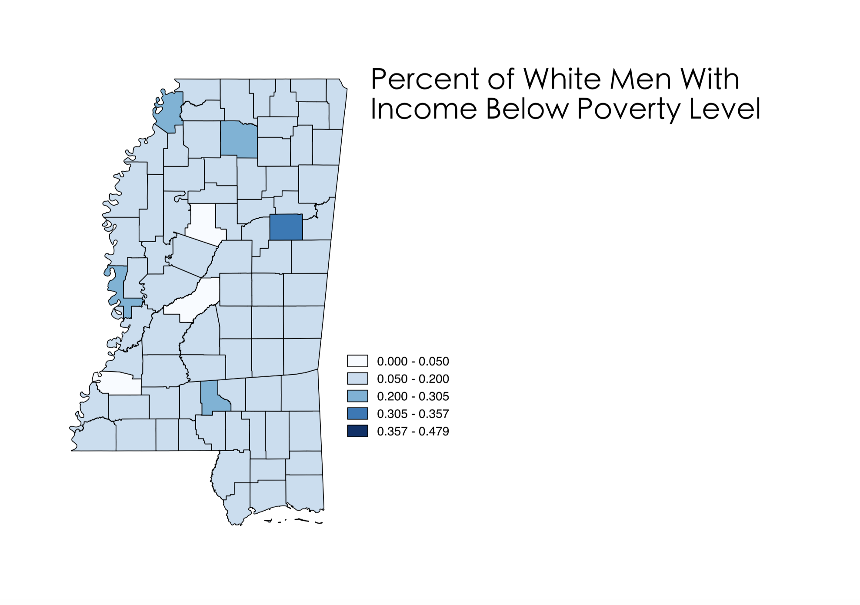
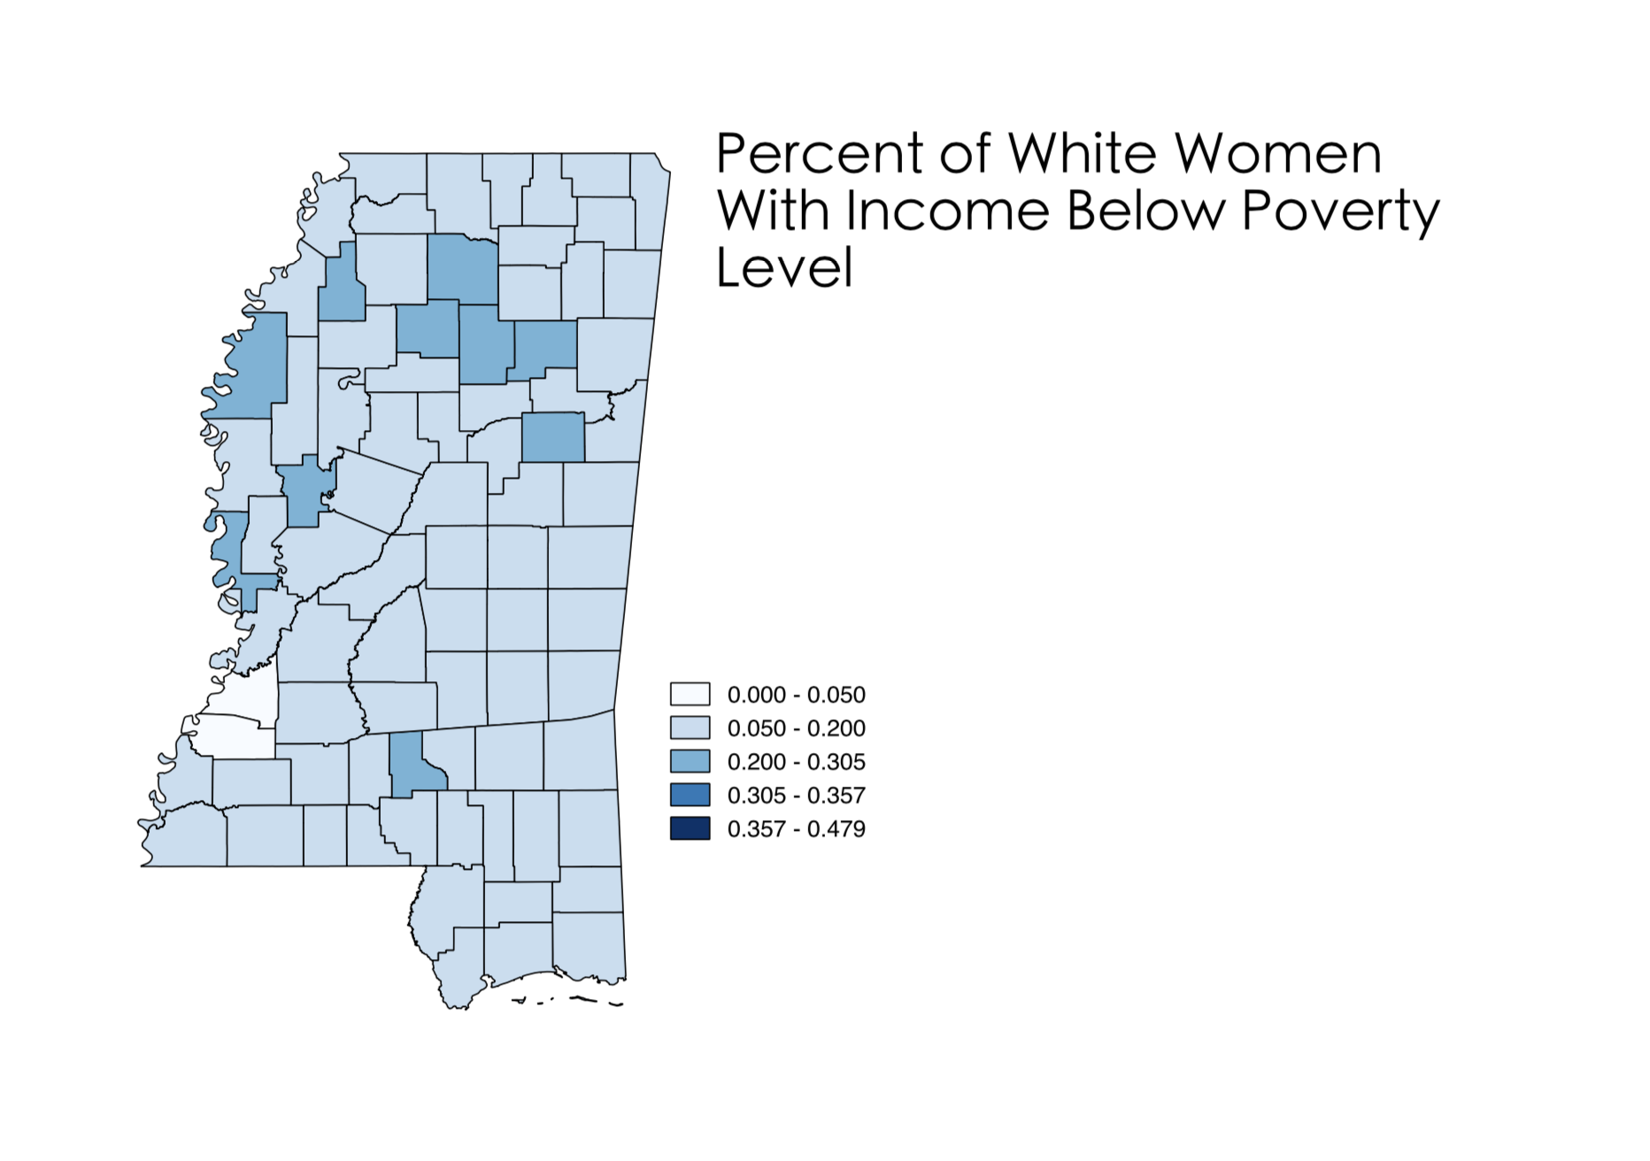
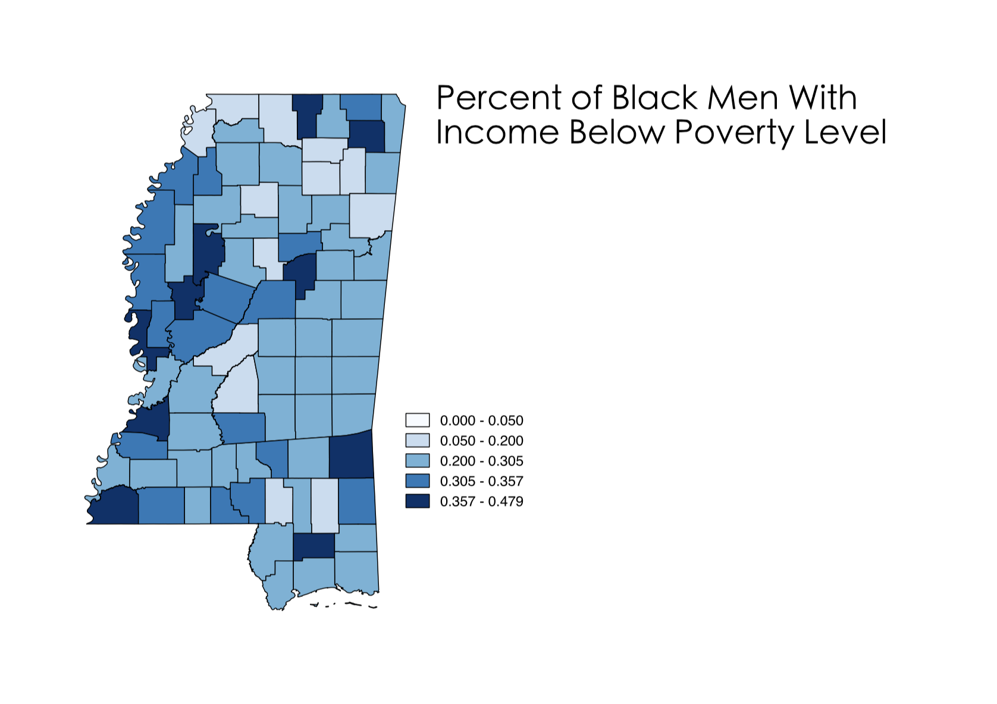
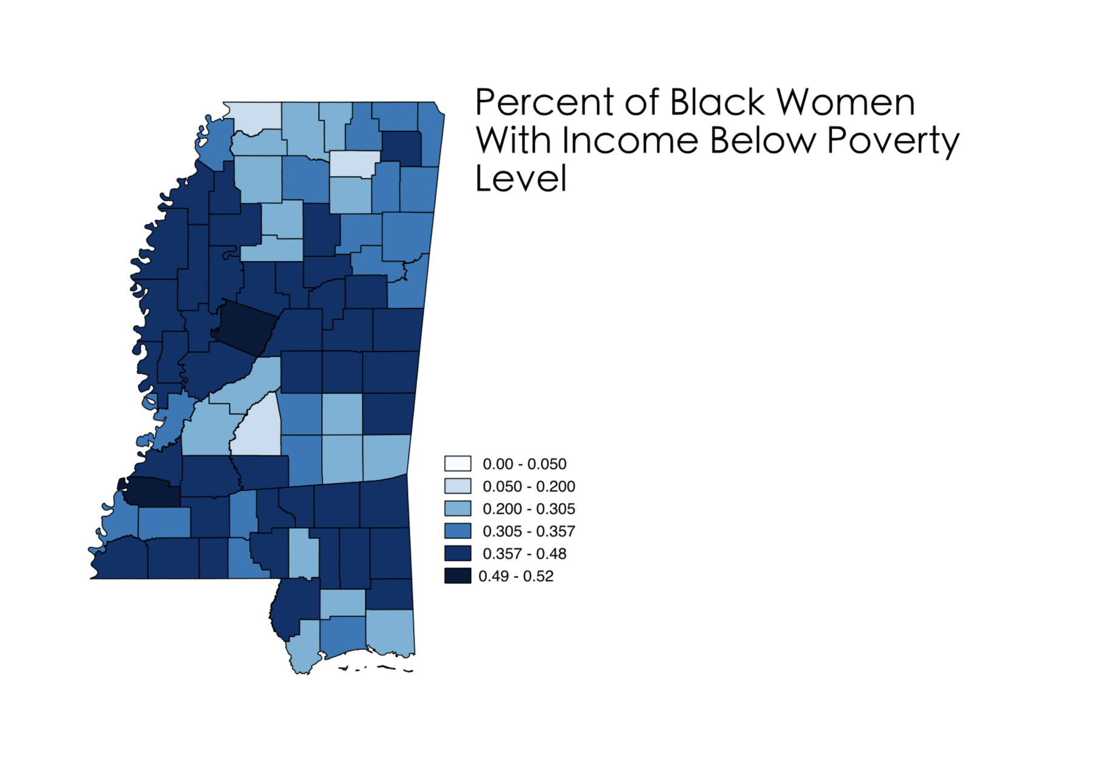
APPLICATIONS

Slide 11
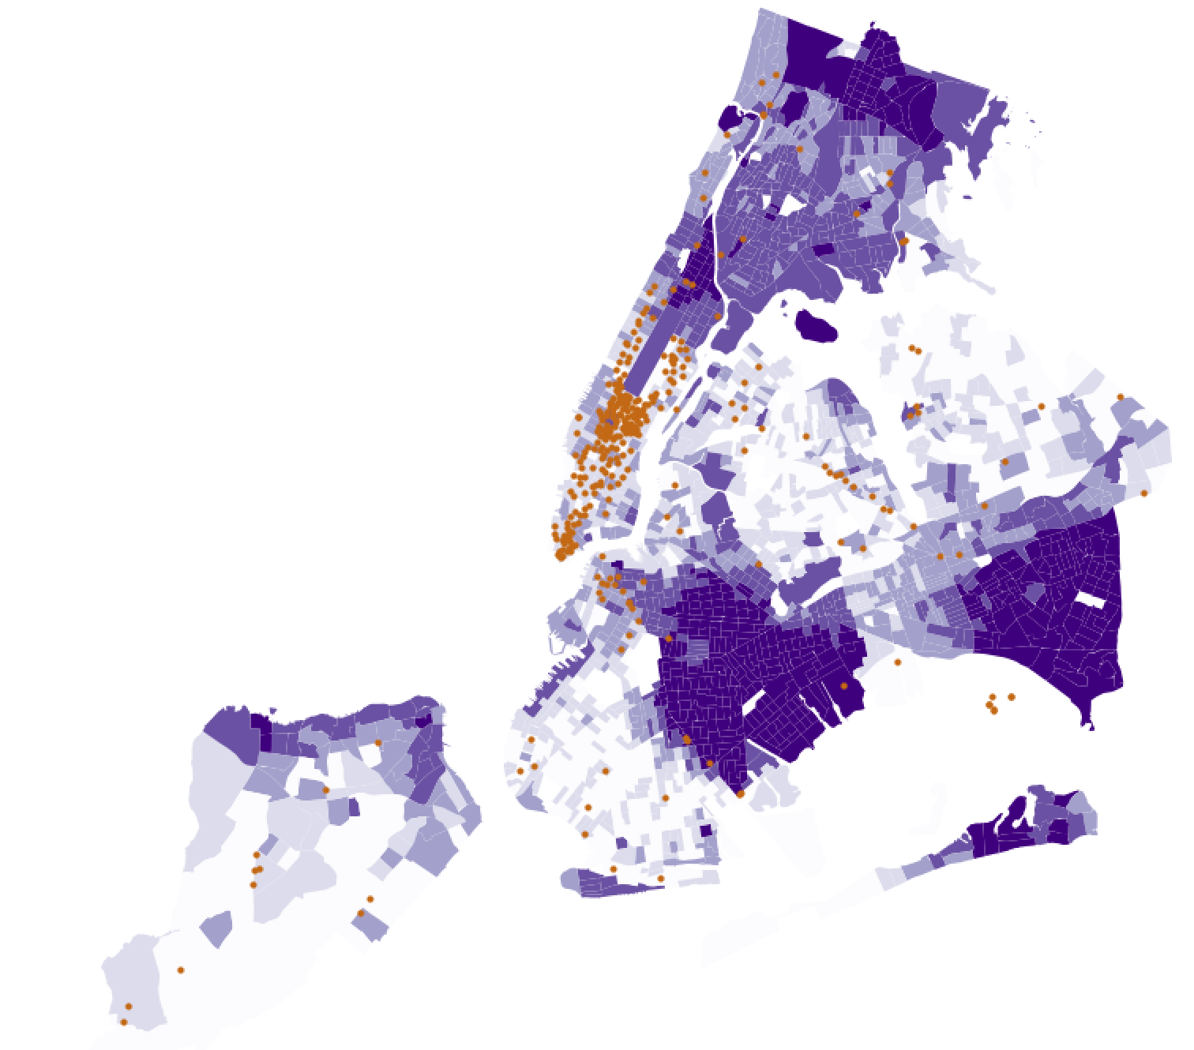
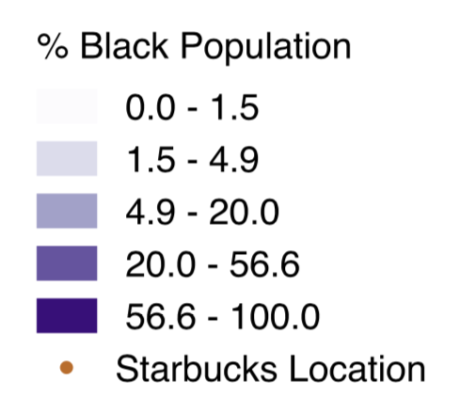
STARBUCKS & RACE

Slide 12
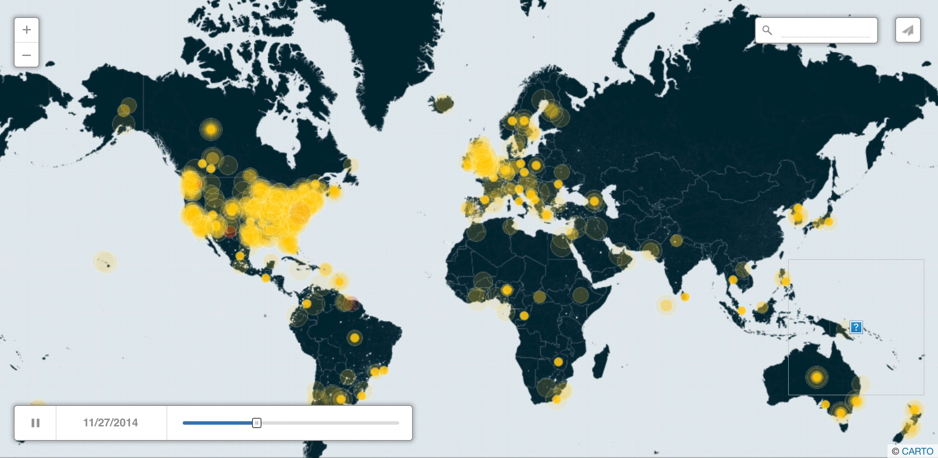
#ICantBreathe,#BlackLivesMatter and #HandsUpDontShoot on Twitter

Slide 13
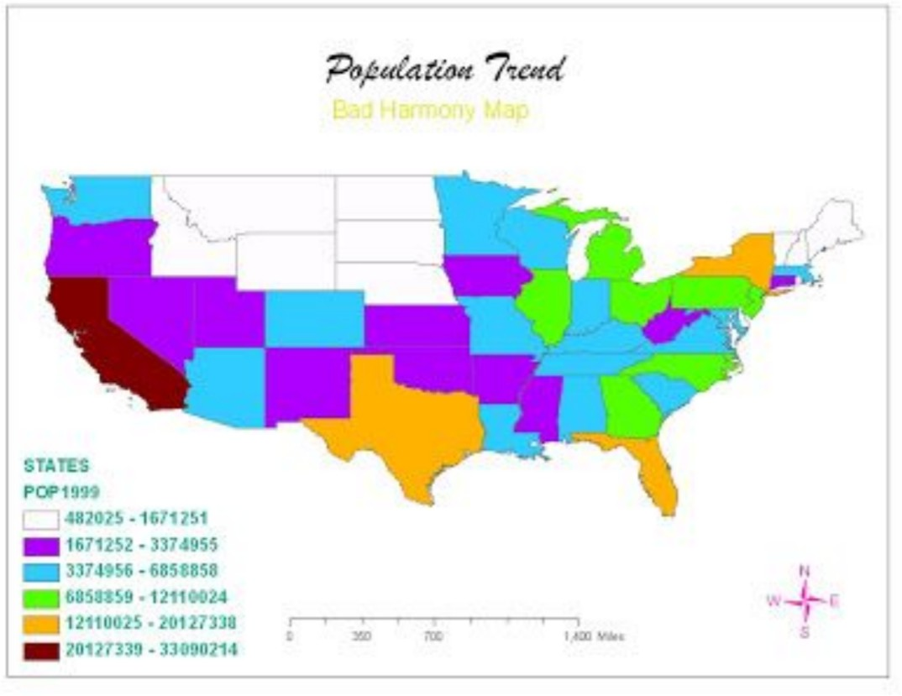

Slide 14
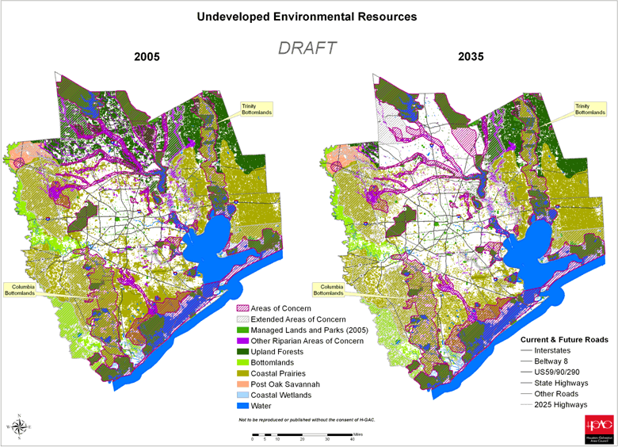

Slide 15
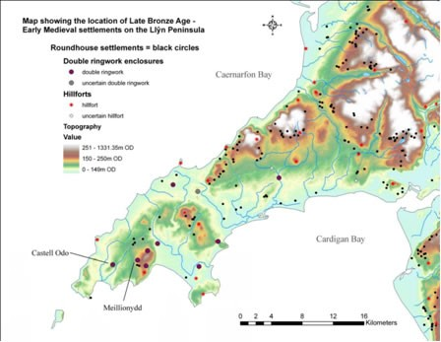

Slide 16
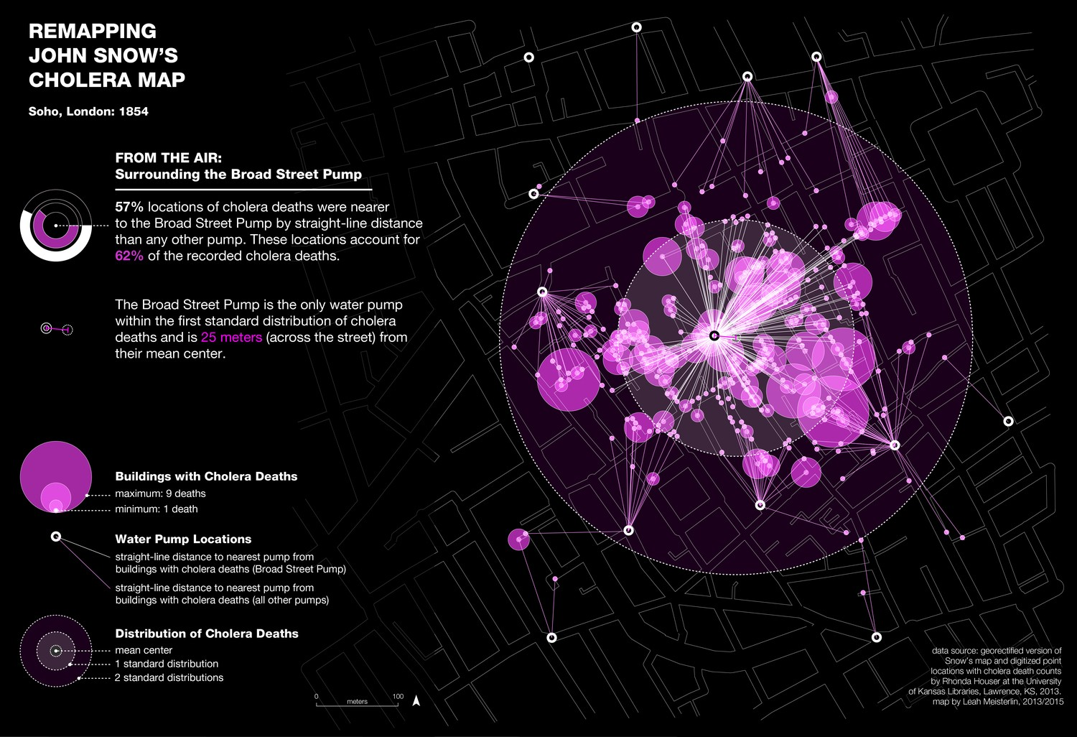

Slide 17
Other Examples
Cities and Income
CoreData.nyc
Affordable Housing

Slide 18
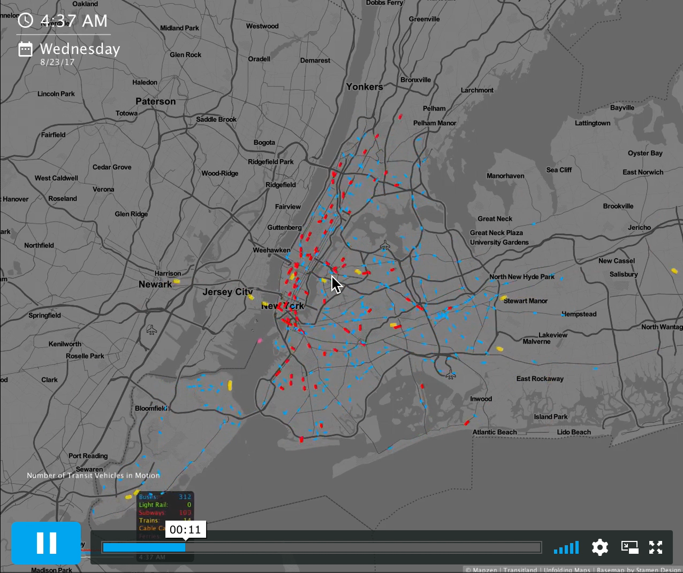
VISUALIZING TRANSIT

Slide 19
MAP ELEMENTS
TITLE - DESCRIPTIVE
DATA SOURCE CLEAR LEGEND - WITH EXPLANATION SCALE BAR - IN UNITS THAT MAKE SENSE NORTH ARROW - AT AN APPROPRIATE SIZE
PROPERLY PROJECTED MAP ANY NECESSARY LABELS
NAME AND DATE

Slide 20
NOW, LET’S MAKE A MAP!

